Slide 2
HELLO
my name is
Garrett
 @StatGarrett
CC BY-SA RStudio
Notes:
* introduce yourself

Slide 3
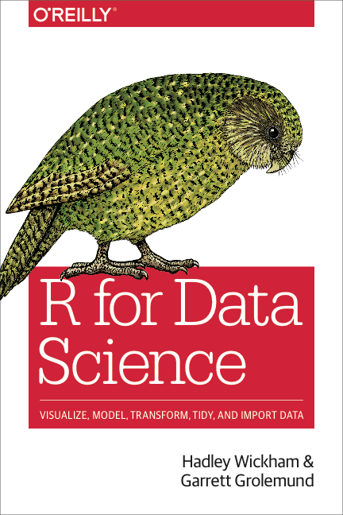
CC BY-SA RStudio

Slide 4
HELLO
my name is
TA
 @TA
CC BY-SA RStudio

Slide 5
HELLO
my name is
TA
CC BY-SA RStudio

Slide 6
Day 1
Introduction and Visualize Data | 9:00 - 10:45
Morning Break | 10:45 - 11:00
Transform Data | 10:30 - 12:30
Lunch | 12:30 - 2:00
Transform Data | 2:00 - 3:15
Afternoon Break | 3:15 - 3:30
Tidy Data | 3:30 - 5:00
CC BY-SA RStudio

Slide 7
Day 1
Introduction and Data Visualization | 9:00 - 10:30
Morning Break | 10:30 - 10:45
Data Visualization | 10:45 - 12:00
Lunch | 12:00 - 1:00
Transforming Data | 1:00 - 3:15
Afternoon Break | 3:15 - 3:30
Tidy Data and Importing Data | 3:30 - 5:00
CC BY-SA RStudio

Slide 8
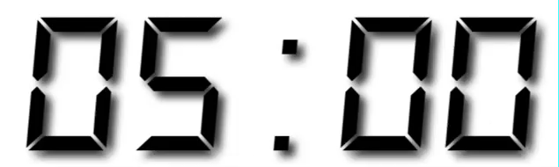
Your Turn
Form groups of 2-4 people. Introduce yourself to your group members. Tell them:
Who you are
What you do with data
How long you have been using R
Notes:
* get students discussing immediately to set the tone for participation

Slide 9
"Data Science"
Design Experiment
Form Hypothesis
Collect
Data
Communicate Results
Explore or Test
CC BY-SA RStudio
Notes:
* You can describe the scientific process in many ways, but they each tend to boil down to something like this

Slide 10

Import data into software
Collect
Data
Tidy data into useable form
Design Experiment
Explore or Test
Form Hypothesis
Transform the data. Do feature engineering.
Deploy app or publish paper
Write code to apply a modeling algorithm.
Build app or write paper
Visualize the data and/or results
Communicate Results
CC BY-SA RStudio
Notes:
but when you work with data, each of these steps requires some behind the scenes work with a computer (in green).
Today and tomorrow we will learn how to do these steps with the R programming language.
There are some real advantages to using R, to see why take a look at what happens when you use a computer…

Slide 11


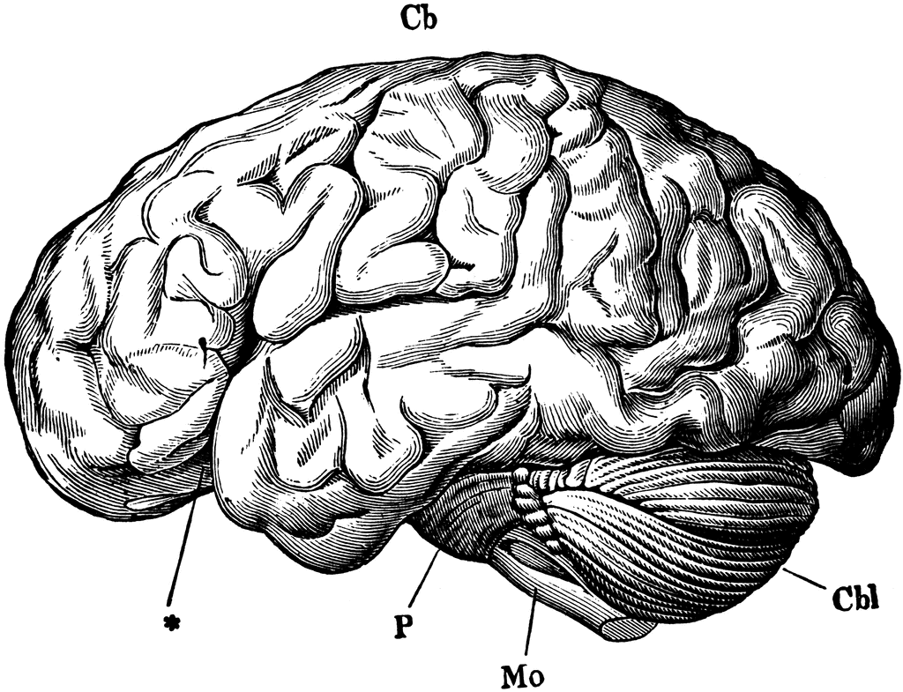
R - A computer language for scientists
C++
Human thought
Machine language
CC BY-SA RStudio
Notes:
When you use a computer you face a challenge: although you think in terms of human language, the computer must run instructions written in machine language. Crossing this gap is difficult to do.
Programming languages make this easier to do. As long as you can express yourself in a language like C++, the language takes care of the rest, which narrows the gap.
But most languages are designed to work efficiently with the computer, not the human, which makes them hard to use. For example, when you translate your thoughts to C++, you need to keep track of computational concerns like declaring variables and incrementing loops.
In contrast, R was designed to work efficiently with humans (no lie). It is noticeably easier to use and easier to learn than most languages. If you place R on the diagram it would look like this. Or more accurately like this…

Slide 12
R - A computer language for scientists
C++
C++
FORTRAN
JavaScript
C++
Human thought
Machine language
CC BY-SA RStudio
Notes:
…because as a general rule R functions call another language under the hood. This could be C++, FORTRAN, JavaScript and many other languages and types of software, like databases and distributed machine learning systems.
Different functions can use different software, which means that well written R functions will use the best technology for the task at hand (and be nearly as fast as the underlying code by itself).
So in other words, you can think of R as a human friendly interface to a universe of high powered tools.

Slide 13
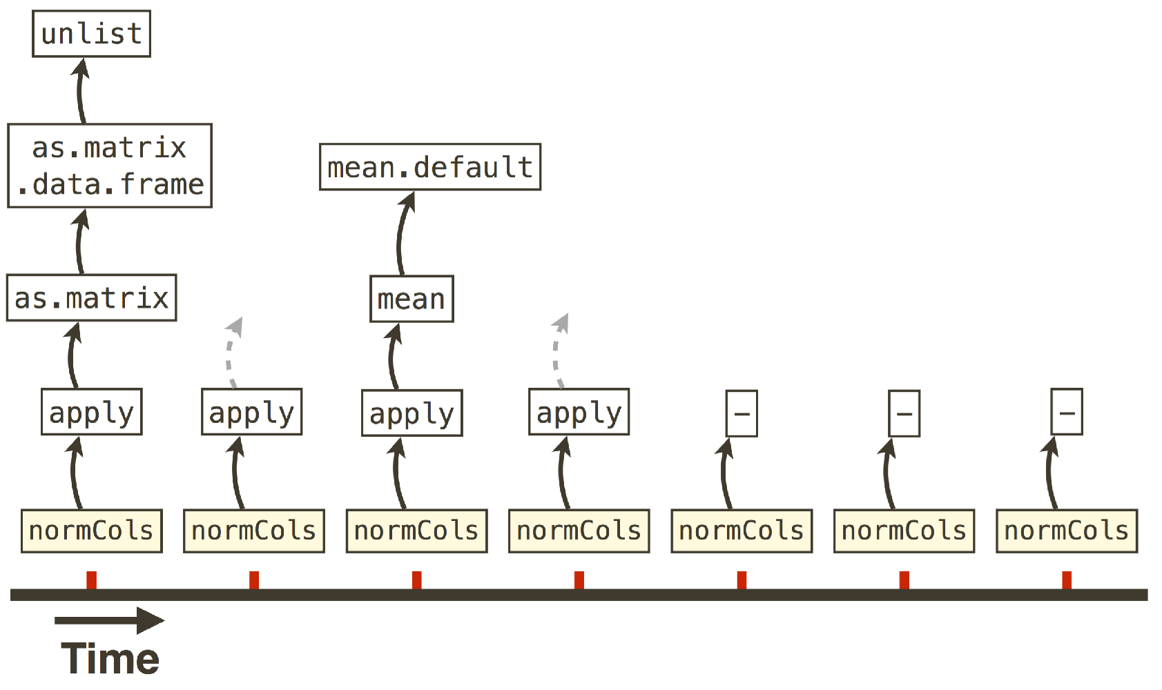
Machine language
C++, FORTRAN, etc.
Human language
CC BY-SA RStudio

Slide 14
R - A computer language for scientists
map()
sapply()
for()
C++
Human thought
Machine language
CC BY-SA RStudio
Notes:
Moreover, over time, R code has evolved to become more and more human friendly.
For example, R began with a function named for(), which closely resembles the for() function in C++ code
Later R developers created the apply family of functions which do the same job in a more intuitive way
Recently, Hadley Wickham and Lionel Henry created the map() family of functions which do the same job in a more intuitive way yet

Slide 15
Neocortex
Limbic
System
Reptilian
Brain
CC BY-SA RStudio
Notes:
…and this process has occurred in other parts of R.
Which means you can think of R in the same way biologists think of the human brain. You r brain is composed of multiple parts that work together but evolved at different stages of evolutionary history. First came the reptilian brain that controls basic functions and the fight or flight response it is very good at what it does, but not very subtle. Later we evolved the limbic system. And finally the neocortex, which we use for planning, abstract thought and other sophisticated tasks.
R is like this. It still contains for() and other brute force functions that are great at what they do, but maybe not very easy to work with. Alongside of these functions R contains more recent parts that do sophisticated tasks and encode the current best practices of computer science and data science.

Slide 16

Neocortex
Limbic
System
Reptilian
Brain
CC BY-SA RStudio
Notes:
were going to focus on one of these parts of R today, known as the tidyverse.
It is one of the most recent parts of R to evolve, and in my opinion one of the most sophisticated and easiest to use.

Slide 17
R Packages

Slide 18

help
help
help
pressure | pressure | pressure | pressure
1007 | 1007 | 1007 | 1007
1009 | 1009 | 1009 | 1009
pressure | pressure | pressure
pressure | pressure | pressure
function1()
function2()
function3()
function4()
CC BY-SA RStudio

Slide 19
help
help
help
help
help
help
help
help
help
help
help
help
pressure | pressure | pressure | pressure
1007 | 1007 | 1007 | 1007
1009 | 1009 | 1009 | 1009
pressure | pressure | pressure
pressure | pressure | pressure | pressure
1007 | 1007 | 1007 | 1007
1009 | 1009 | 1009 | 1009
pressure | pressure | pressure
pressure | pressure | pressure | pressure
1007 | 1007 | 1007 | 1007
1009 | 1009 | 1009 | 1009
pressure | pressure | pressure
pressure | pressure | pressure | pressure
1007 | 1007 | 1007 | 1007
1009 | 1009 | 1009 | 1009
pressure | pressure | pressure
pressure | pressure | pressure
pressure | pressure | pressure
pressure | pressure | pressure
pressure | pressure | pressure
function1()
function2()
function3()
function4()
function5()
function6()
function7()
function8()
function9()
functionA()
functionB()
functionC()
functionD()
functionE()
functionF()
functionG()
Base R
CC BY-SA RStudio

Slide 20
help
help
help
help
help
help
help
help
help
help
help
help
pressure | pressure | pressure | pressure
1007 | 1007 | 1007 | 1007
1009 | 1009 | 1009 | 1009
pressure | pressure | pressure
pressure | pressure | pressure | pressure
1007 | 1007 | 1007 | 1007
1009 | 1009 | 1009 | 1009
pressure | pressure | pressure
pressure | pressure | pressure | pressure
1007 | 1007 | 1007 | 1007
1009 | 1009 | 1009 | 1009
pressure | pressure | pressure
pressure | pressure | pressure | pressure
1007 | 1007 | 1007 | 1007
1009 | 1009 | 1009 | 1009
pressure | pressure | pressure
pressure | pressure | pressure
pressure | pressure | pressure
pressure | pressure | pressure
pressure | pressure | pressure
function1()
function2()
function3()
function4()
function5()
function6()
function7()
function8()
function9()
functionA()
functionB()
functionC()
functionD()
functionE()
functionF()
functionG()
Base R
R Packages
CC BY-SA RStudio

Slide 21
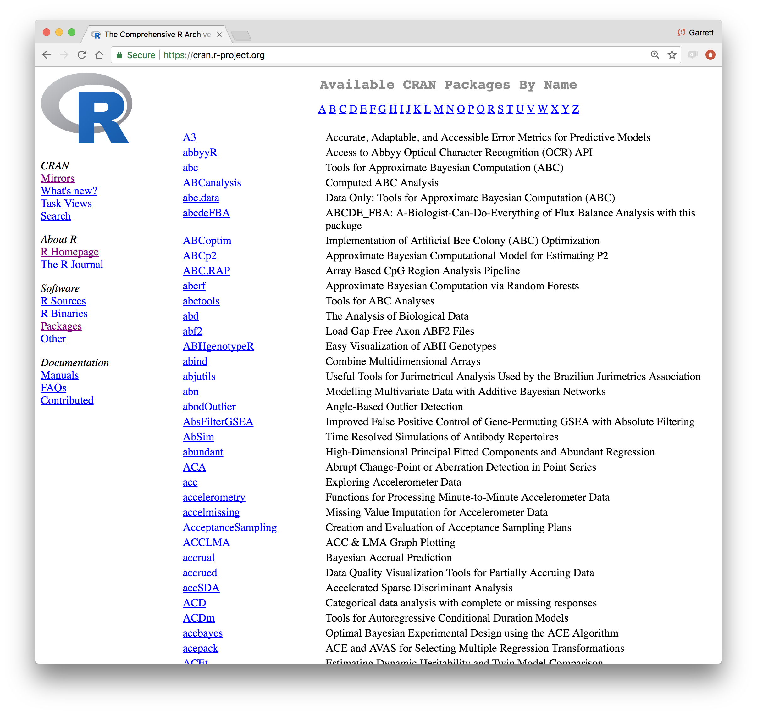
CC BY-SA RStudio

Slide 22
help
help
help
help
help
help
help
help
help
help
help
help
pressure | pressure | pressure | pressure
1007 | 1007 | 1007 | 1007
1009 | 1009 | 1009 | 1009
pressure | pressure | pressure
pressure | pressure | pressure | pressure
1007 | 1007 | 1007 | 1007
1009 | 1009 | 1009 | 1009
pressure | pressure | pressure
pressure | pressure | pressure | pressure
1007 | 1007 | 1007 | 1007
1009 | 1009 | 1009 | 1009
pressure | pressure | pressure
pressure | pressure | pressure | pressure
1007 | 1007 | 1007 | 1007
1009 | 1009 | 1009 | 1009
pressure | pressure | pressure
pressure | pressure | pressure
pressure | pressure | pressure
pressure | pressure | pressure
pressure | pressure | pressure
function1()
function2()
function3()
function4()
function5()
function6()
function7()
function8()
function9()
functionA()
functionB()
functionC()
functionD()
functionE()
functionF()
functionG()
CC BY-SA RStudio

Slide 23
help
help
help
help
help
help
help
help
help
help
help
help
pressure | pressure | pressure | pressure
1007 | 1007 | 1007 | 1007
1009 | 1009 | 1009 | 1009
pressure | pressure | pressure
pressure | pressure | pressure | pressure
1007 | 1007 | 1007 | 1007
1009 | 1009 | 1009 | 1009
pressure | pressure | pressure
pressure | pressure | pressure | pressure
1007 | 1007 | 1007 | 1007
1009 | 1009 | 1009 | 1009
pressure | pressure | pressure
pressure | pressure | pressure | pressure
1007 | 1007 | 1007 | 1007
1009 | 1009 | 1009 | 1009
pressure | pressure | pressure
pressure | pressure | pressure
pressure | pressure | pressure
pressure | pressure | pressure
pressure | pressure | pressure
function1()
function2()
function3()
function4()
function5()
function6()
function7()
function8()
function9()
functionA()
functionB()
functionC()
functionD()
functionE()
functionF()
functionG()
Base R
CC BY-SA RStudio

Slide 24
help
help
help
help
help
help
help
help
help
help
help
help
pressure | pressure | pressure | pressure
1007 | 1007 | 1007 | 1007
1009 | 1009 | 1009 | 1009
pressure | pressure | pressure
pressure | pressure | pressure | pressure
1007 | 1007 | 1007 | 1007
1009 | 1009 | 1009 | 1009
pressure | pressure | pressure
pressure | pressure | pressure | pressure
1007 | 1007 | 1007 | 1007
1009 | 1009 | 1009 | 1009
pressure | pressure | pressure
pressure | pressure | pressure | pressure
1007 | 1007 | 1007 | 1007
1009 | 1009 | 1009 | 1009
pressure | pressure | pressure
pressure | pressure | pressure
pressure | pressure | pressure
pressure | pressure | pressure
pressure | pressure | pressure
function1()
function2()
function3()
function4()
function5()
function6()
function7()
function8()
function9()
functionA()
functionB()
functionC()
functionD()
functionE()
functionF()
functionG()
Base R
R Packages
CC BY-SA RStudio

Slide 25
Using packages
1
2
install.packages("foo")
library("foo")
Downloads files to computer
Loads package
1 x per computer
1 x per R Session
CC BY-SA RStudio

Slide 26
The Tidyverse

Slide 27
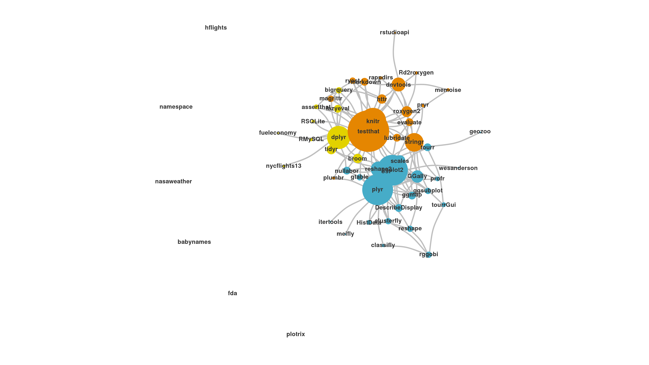
The Tidyverse
A collection of modern R packages that share common philosophies, embed best practices, and are designed to work together.
CC by RStudio
CC BY-SA RStudio
Display by Adolfo A ́lvarez

Slide 28
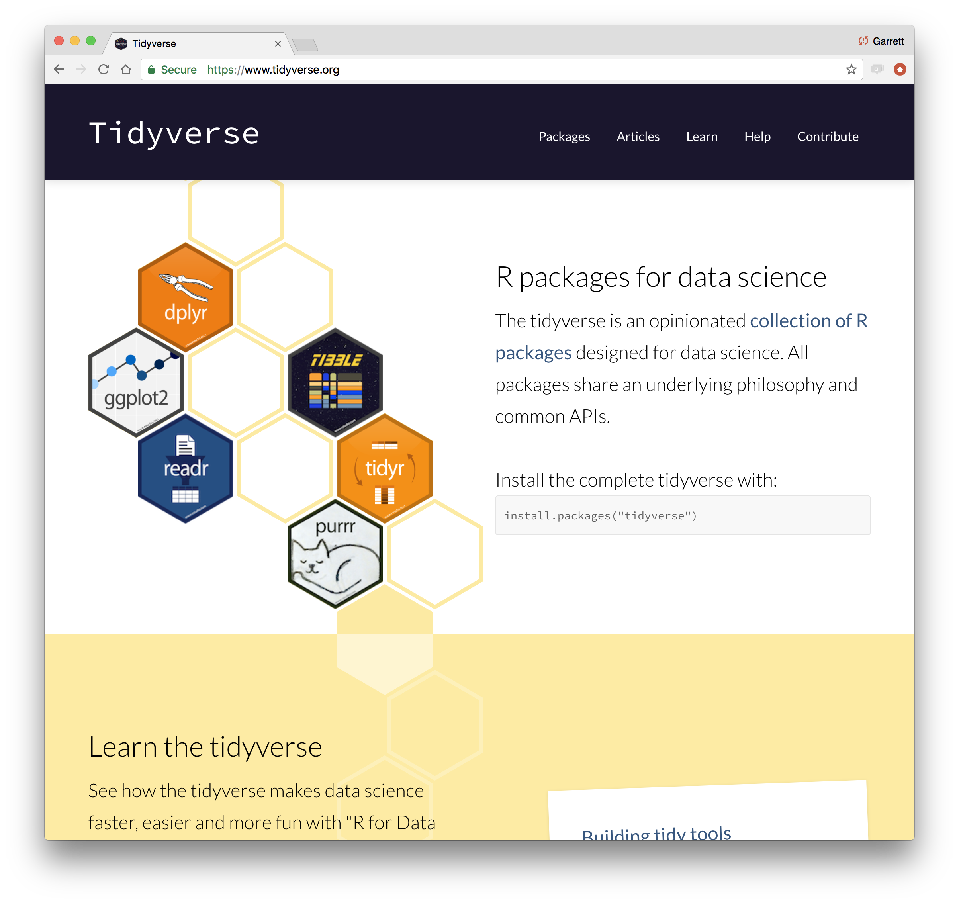
tidyverse.org
CC BY-SA RStudio

Slide 29
tidyverse
An R package that serves as a short cut for installing and loading the components of the tidyverse.
library("tidyverse")
CC BY-SA RStudio

Slide 30
tidyverse
An R package that serves as a short cut for installing and loading the components of the tidyverse.
library("tidyverse")
CC BY-SA RStudio

Slide 31
install.packages("tidyverse")
does the equivalent of
install.packages("ggplot2")
install.packages("dplyr")
install.packages("tidyr")
install.packages("readr")
install.packages("purrr")
install.packages("tibble")
install.packages("hms")
install.packages("stringr")
install.packages("lubridate")
install.packages("forcats")
install.packages("DBI")
install.packages("haven")
install.packages("httr")
install.packages("jsonlite")
install.packages("readxl")
install.packages("rvest")
install.packages("xml2")
install.packages("modelr")
install.packages("broom")
CC BY-SA RStudio

Slide 32
install.packages("tidyverse")
library("tidyverse")
does the equivalent of
does the equivalent of
install.packages("ggplot2")
install.packages("dplyr")
install.packages("tidyr")
install.packages("readr")
install.packages("purrr")
install.packages("tibble")
install.packages("hms")
install.packages("stringr")
install.packages("lubridate")
install.packages("forcats")
install.packages("DBI")
install.packages("haven")
install.packages("httr")
install.packages("jsonlite")
install.packages("readxl")
install.packages("rvest")
install.packages("xml2")
install.packages("modelr")
install.packages("broom")
library("ggplot2")
library("dplyr")
library("tidyr")
library("readr")
library("purrr")
library("tibble")
CC BY-SA RStudio

Slide 33
Import data into software
Collect
Data
Tidy data into useable form
Design Experiment
Explore or Test
Form Hypothesis
Transform the data. Do feature engineering.
Deploy app or publish paper
Write code to apply a modeling algorithm.
Build app or write paper
Visualize the data and/or results
Communicate Results
CC by RStudio
CC BY-SA RStudio
Display by Adolfo A ́lvarez

Slide 34
Tidy tools
Functions are easiest to use when they are:
Simple - They do one thing, and they do it well
Composable - They can be combined with other functions for multi-step operations
Smart - They can use R objects as input.
Tidy functions do these things in a specific way.
CC BY-SA RStudio

Slide 35
Tidy data
Tidy functions all expect and return the same data structure, known as tidy data:
CC BY-SA RStudio

Slide 36

Your Turn
Discuss in your group:
"What is the difference between a number and a piece of data?"

Slide 37
"Data are not just numbers,
they are numbers with a context."
- George Cobb and David Moore (1997)

Slide 38
Subject (car) | Speed (mph) | Distance (ft)
1 | 25 | 85
2 | 24 | 120
3 | 24 | 93
4 | 24 | 92
Subject (car) | Speed (mph) | Distance (ft)
1 | 25 | 85
2 | 24 | 120
3 | 24 | 93
4 | 24 | 92
Subject (car) | Speed (mph) | Distance (ft)
1 | 25 | 85
2 | 24 | 120
3 | 24 | 93
4 | 24 | 92
Every value is associated with:
A variable
An observation (case)
CC BY-SA RStudio

Slide 39
Tidy data
Tidy functions all expect and return the same data structure, known as tidy data:
A data frame that contains
variables in the columns and
cases in the rows.
CC BY-SA RStudio

Slide 40
R Notebooks
(Let's start!)

Slide 41
Your Turn
Open 00-Introduction.Rmd. Read through the notebook and do everything it tells you to do.

Slide 42
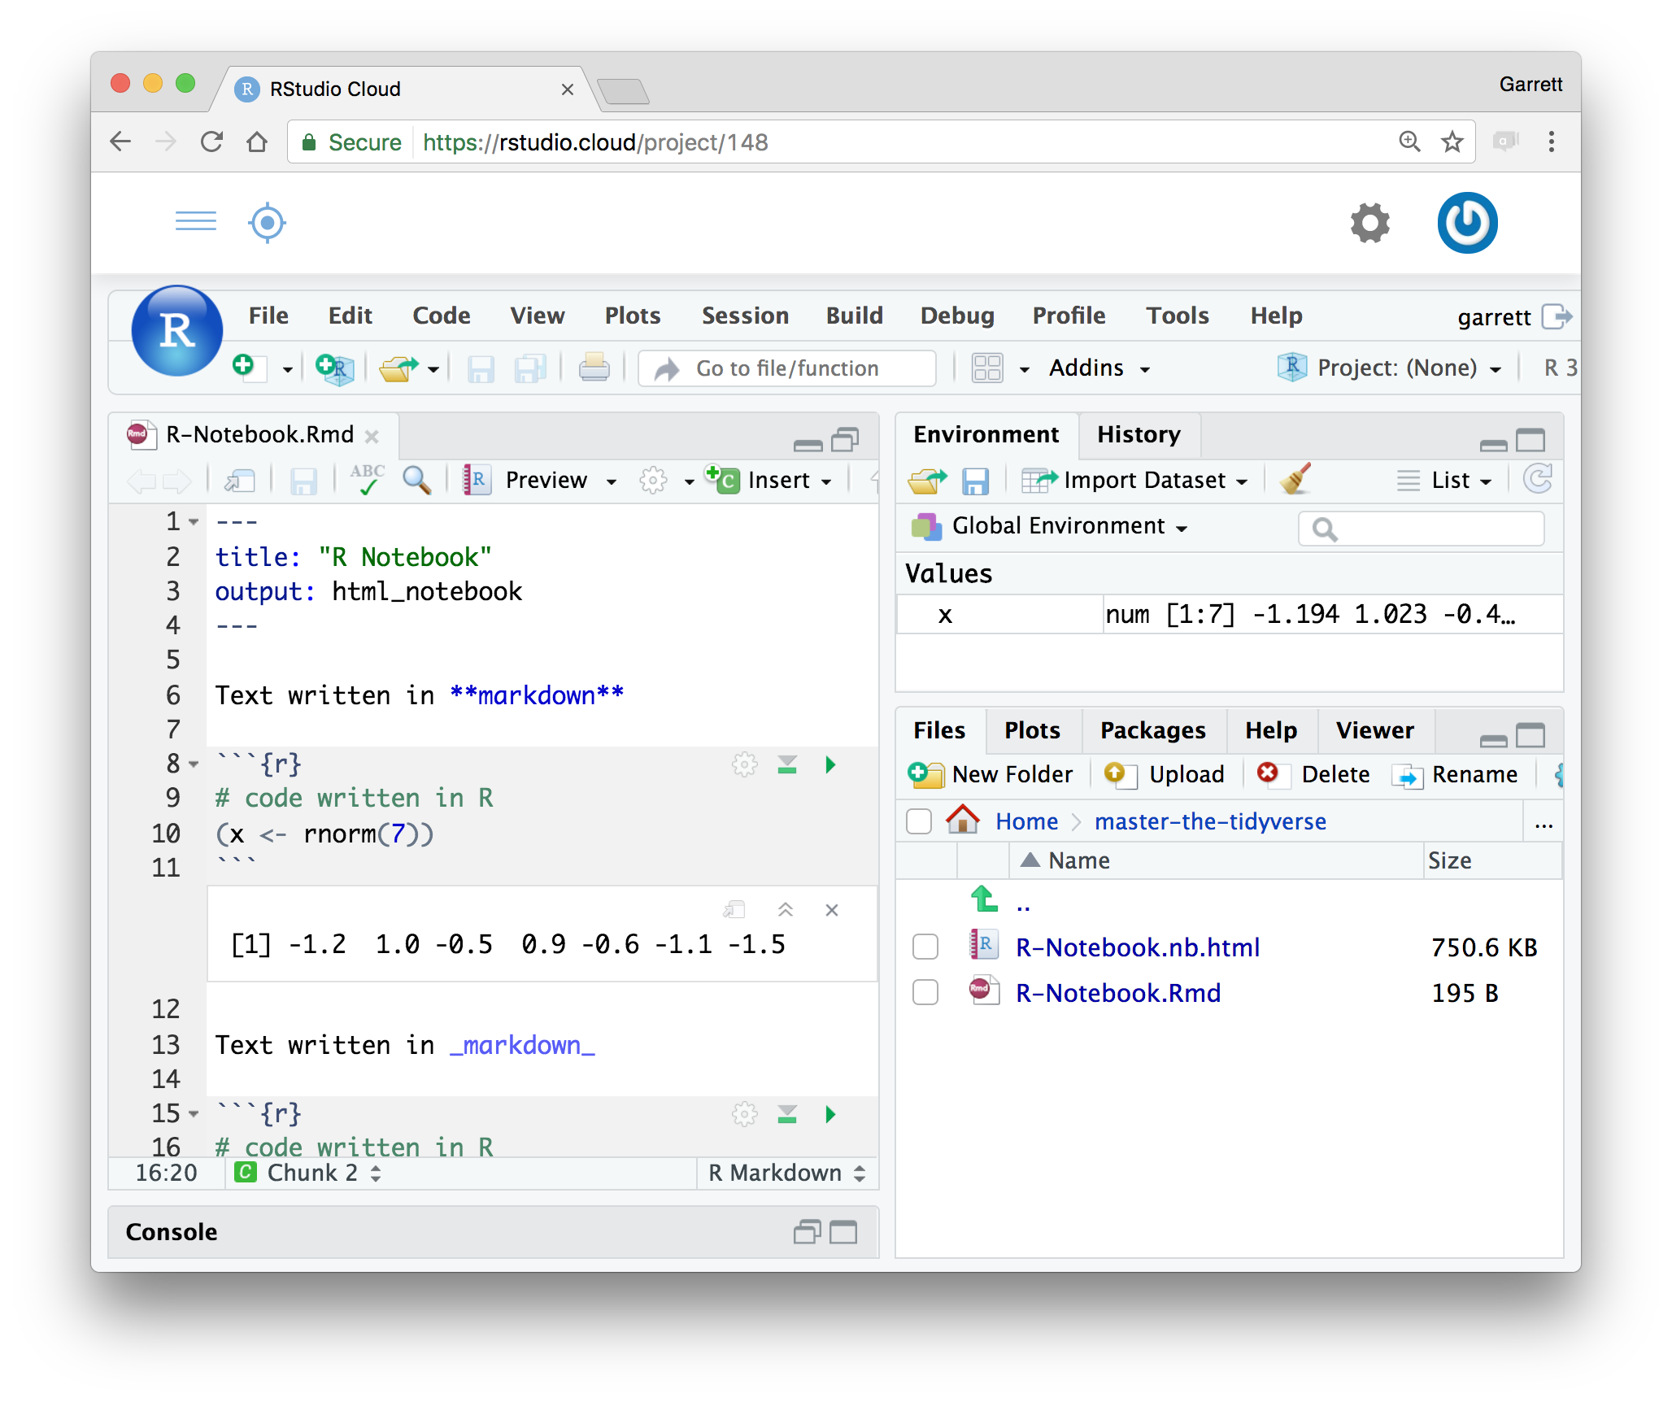
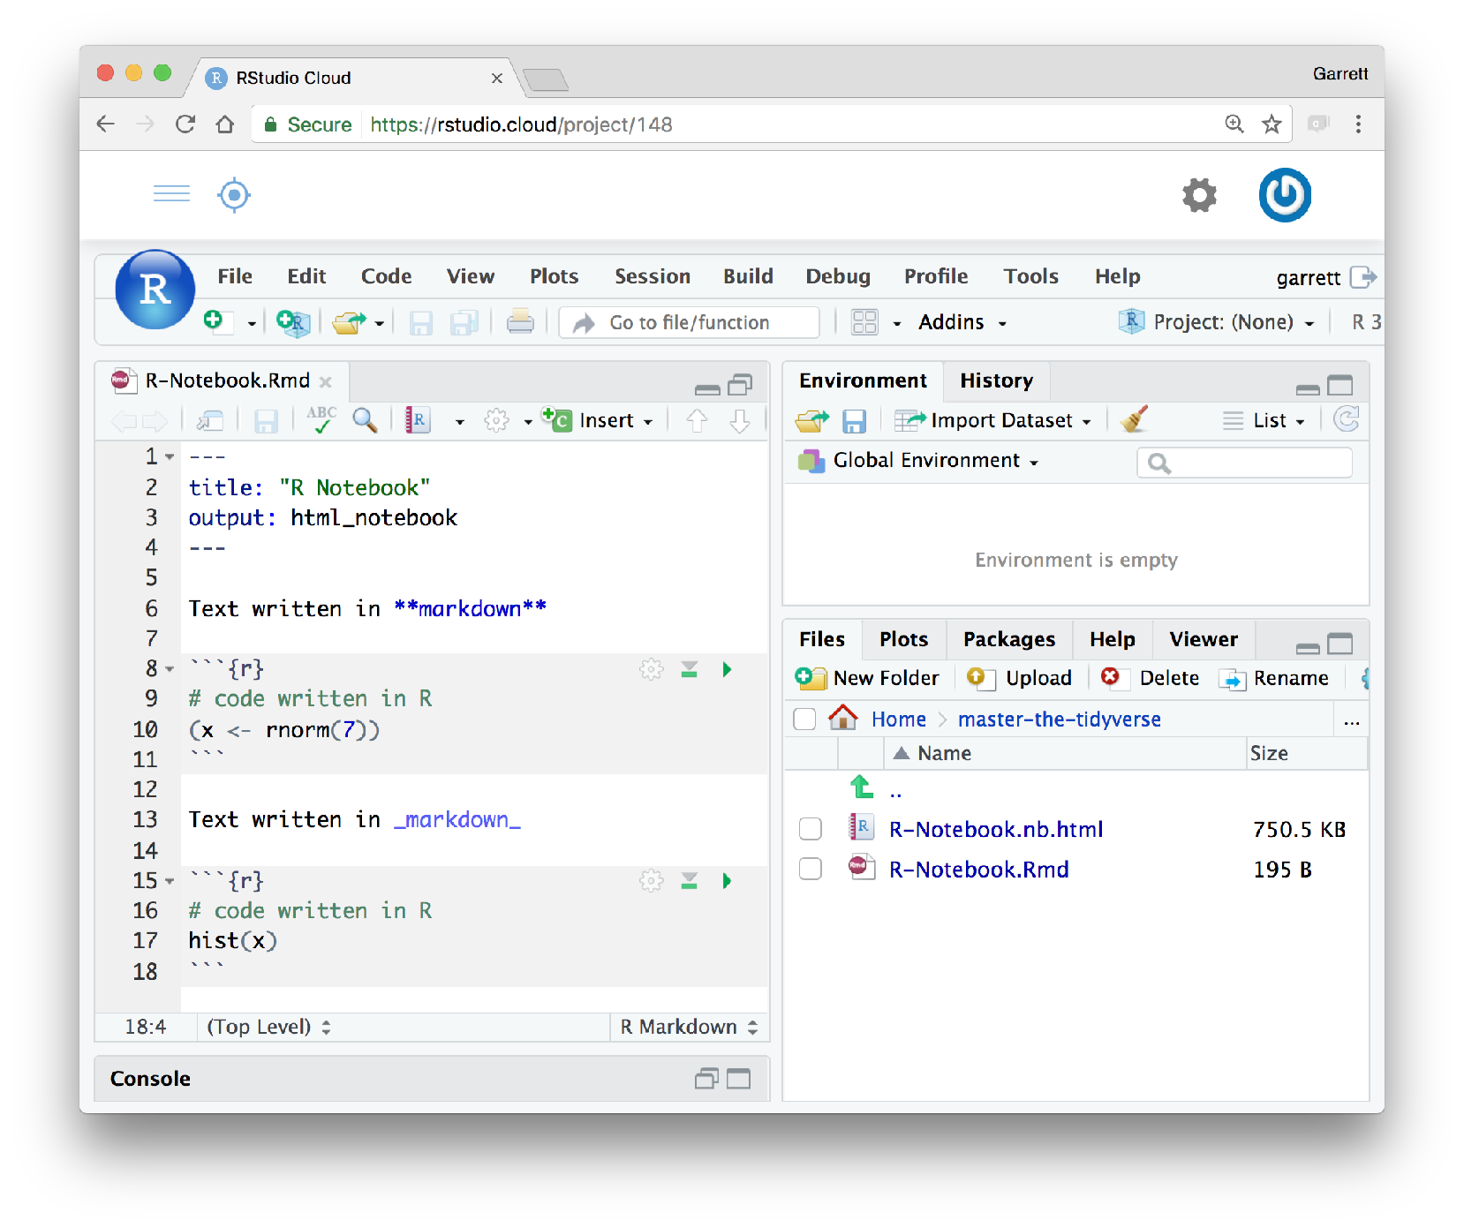
R Notebooks
An authoring format for Data Science.
Click to run all code chunks above
Click to run code in chunk
Code result
Click on .Rmd file to open notebook
CC BY-SA RStudio

Slide 43
Outro

Slide 44
Import data into software
Collect
Data
Tidy data into useable form
Design Experiment
Explore or Test
Form Hypothesis
Transform the data. Do feature engineering.
Deploy app or publish paper
Write code to apply a modeling algorithm.
Build app or write paper
Visualize the data and/or results
Communicate Results
CC BY-SA RStudio

Slide 45
(Applied) Data Science
Visualize the data and/or results
Visualize
Build app or write paper
Import data into software
Tidy data into useable form
Write code to apply a modeling algorithm.
Import
Tidy
Model
Communicate
Deploy app or publish paper
Transform the data. Do feature engineering.
Transform
Program
CC BY-SA RStudio

Slide 46
(Applied) Data Science
Visualize
Import
Tidy
Model
Communicate
Transform
Program
CC BY-SA RStudio

Slide 47
R - A computer language for scientists
map()
sapply()
for()
C++
Human thought
Machine language
CC BY-SA RStudio

Slide 48
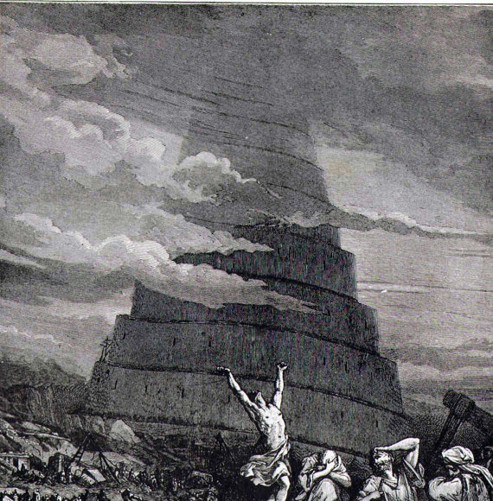
CC BY-SA RStudio

Slide 49

Your Turn
Open 01-Visualize-Data.Rmd.

